Slide 1

Big Mountain Resort Ski Facilities
February 22, 2021

Slide 2
Problem Statement
Big Mountain Resort is experiencing an operating cost increase of $1.54MM after the addition of a new ski lift
There are concerns about current pricing and facility investment strategies
Potential scenarios are being considered for either cutting costs or increasing revenue
Permanently close up to 10 of the least used runs
Increase the vertical drop, add a run, install additional lift
Add 2 acres of snow making cover, plus above bullet
Increase the longest run and increase snow making acreage
Revenue increases will also be targeted through the evaluation of potential lift ticket price increases with current resort facilities

Slide 3
Recommendation & Key Findings
Big Mountain should increase lift ticket prices from $81 to $85 with the current ski facilities as they are today
Big Mountain Resort modelled price is $94.22, actual price is $81.00
Even with the expected mean absolute error of $10.39, this suggests there is room for an increase
Additional facility improvements should be considered for future opportunities to increase lift ticket price due to improved value
Modeling was completed without state level considerations effectively treating the competitive market as the full U.S. ski market
Final recommendation does consider lift ticket pricing position in Montana, along with tourism challenges, and results in a less aggressive price point than suggested by modeling

Slide 4
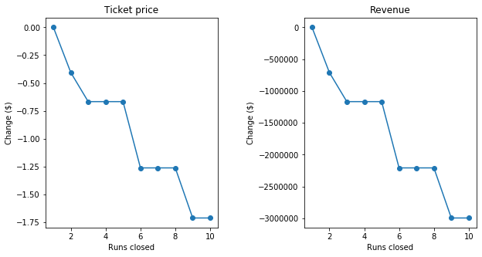
Recommendation & Key Findings
Closing runs may help with operational costs but it decreases ticket value
Adding a run, increasing vertical drop, and adding a lift increases ticket value by $8.46
Adding 2 acres of snow making increases ticket value by $1.29
Increasing the longest run by 0.2 miles and ensuring snow making coverage has no effect on the value of a lift ticket

Slide 5
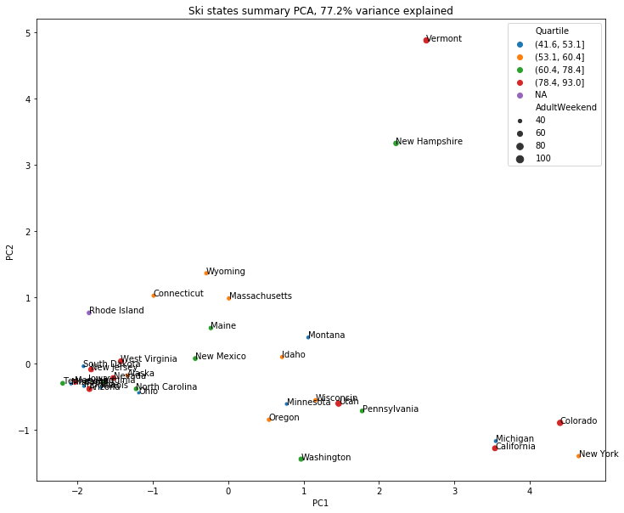
Principle Component Analysis
7 numerical state features were ranked, and the top 2 principal components are displayed here
With over 75% of the variance explained with PC1 and PC2, there is no obvious pattern between ticket price and components
Most state data was removed prior to modeling

Slide 6
Train/Test Split
Used ski resort data excluding Big Mountain as our features and assigned lift ticket prices to our target label
Proceeded to impute missing values, scale the data, make predictions and evaluate performance of each model
2 models and the average ticket price were evaluated to determine best use for predicting Big Mountain’s lift ticket price
Raw average of $64, used as a baseline performance with no model, resulted in MAE of $19.14
Linear regression model resulted in MAE of $11.79
Random forest regression model resulted in MAE of $9.50

Slide 7
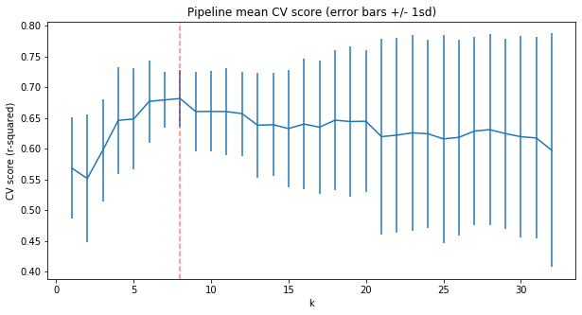
Cross-Validation with Linear Model
Cross-validation technique was implemented to address concerns of overfitting with arbitrary test set
GridSearchCV identified best value for parameter k to be 8
Identified largest positive features
Vertical drop
Snow making
Total chairs
Fast quads
Final MAE of $11.79

Slide 8
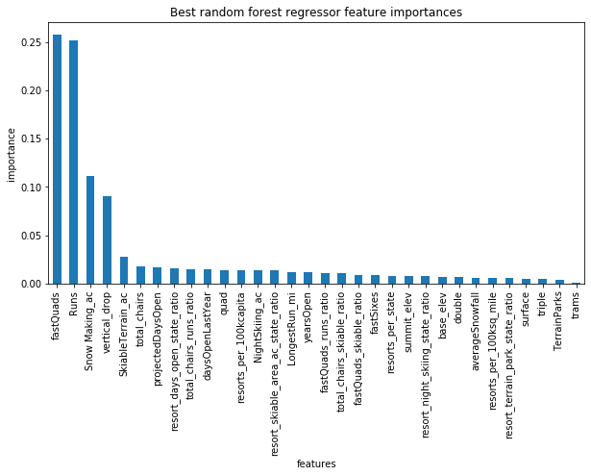
Random Forest Regression
Model performance was assessed using cross-validation
Imputing missing values with median of respective category was helpful, scaling the data was not
Identified feature importance with resulting top features aligned with our linear model results
Final MAE of $9.50

Slide 9
Conclusion
Big Mountain Resort is experiencing an operating cost increase of $1.54MM after the addition of a new ski lift
The company can benefit from a lift ticket price increase of $4 with potential revenue growth of up to $7,000,000 with current facilities
Adding a run, increasing vertical drop, and adding a lift increases ticket value by $8.46 and should be considered for future opportunities to increase lift ticket price due to improved value

